Slide 1
Bypassing Palo Alto Firewall Rules One Packet at a Time
Dave Lassalle
NolaSec Presentation
9/27/2012

Slide 2
About Me
Involved with InfoSec for 9 years
DM Petroleum Operations
M&O Contractor for Strategic Petroleum Reserve
Senior Cyber Security Engineer
Security Monitoring, Incident Detection, Incident Response
Risk Analyses and Compliance Paperwork
Maintain and Administer Security tools
Including Firewalls…

Slide 3
Egress Buster
Released in February by Dave Kennedy (@dave_rel1k)
Useful for finding what ports are open from within a network to the Internet
Helpful with determining reverse shell port
Run server on a range of ports and tell the client to try to connect on every port

Slide 4
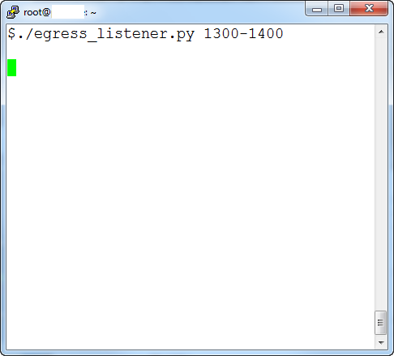
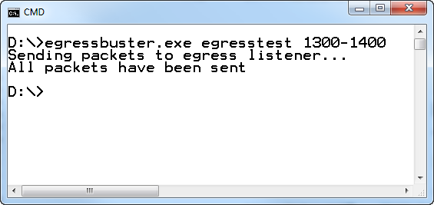
Egress Buster Expected Results
Client
Server

Slide 5
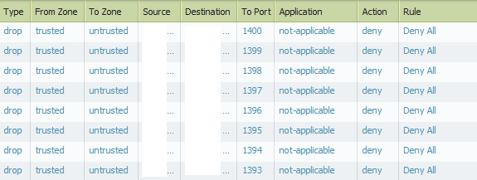
Logs during Blocked Egress Buster run
All traffic to the server in that port range is denied.

Slide 6
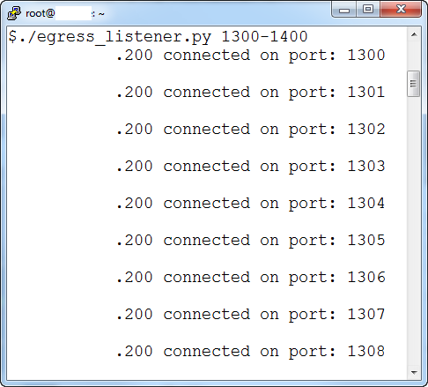

Egress Buster Actual Results
Well, there’s supposed to be a firewall there. What’s going on?
Client
Server

Slide 7
Firewall Overview
Traditional Firewall
Next-Gen Firewall
Network and Transport Layer
Allow/Deny rules based on:
Source IP, Port
Destination IP, Port
Application Layer
Added features
“IPS” features
AV
Vulnerability Detection
DLP
Application Identification

Slide 8
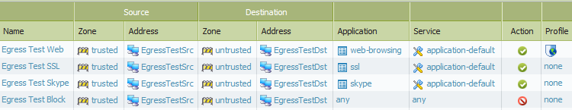
Rules Used in Test
Allow web browsing, ssl, and skype on their default ports.

Slide 9
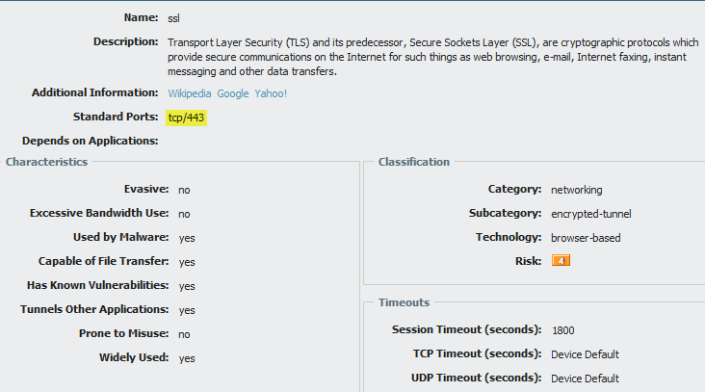
Application Definitions
“ssl” application

Slide 10
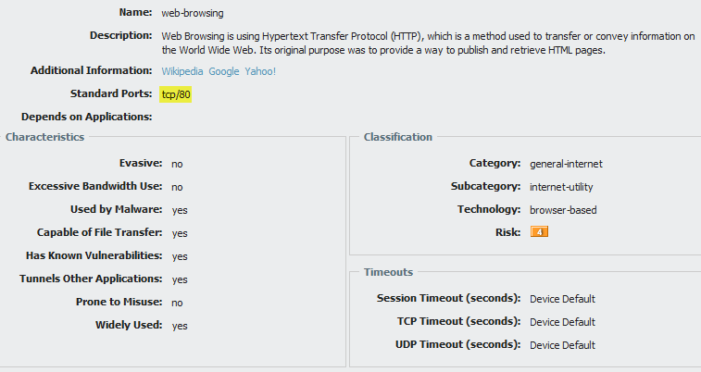
Application Definitions
“web-browsing” application

Slide 11
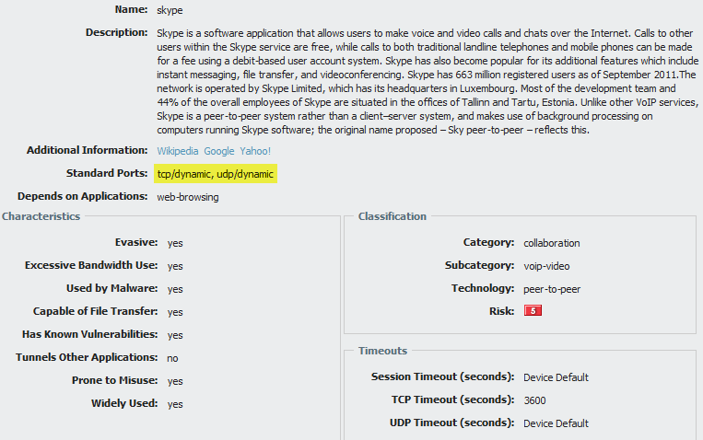
Application Definitions
“skype” application

Slide 12
Why Egress Buster is allowed
App-ID requires some traffic be allowed
TCP handshake and at least 1 packet of payload
Skype’s port tcp/dynamic
At least 1 packet allowed on ALL PORTS
Connection will be dropped if payload is not actual Skype traffic
At least 1 packet of data has already egressed

Slide 13
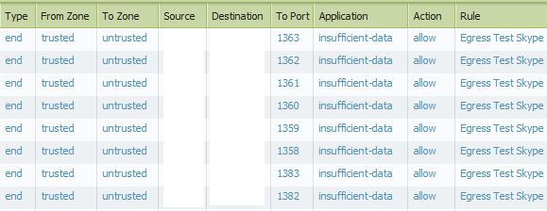
Logs during Egress Buster run
Top: Expected logs when traffic is blocked (as shown on earlier slide)
Bottom: Actual logs when traffic is allowed. Application is insufficient-data because it’s still trying to identify.

Slide 14
How Many Packets Get Through?
Tested with netcat
Typing a few characters on command line
10-12 packets allowed
~40-50 bytes allowed
Piping a file into netcat
2-4 full 1460 byte packets allowed
2920-5840 bytes allowed
All you need is one

Slide 15
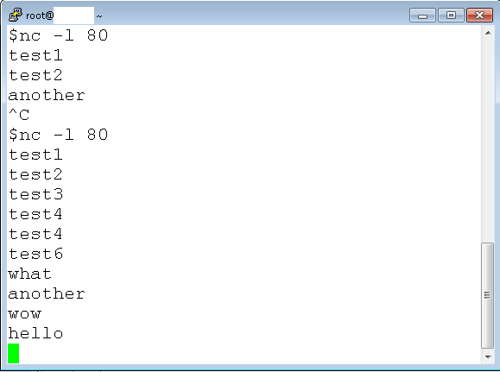
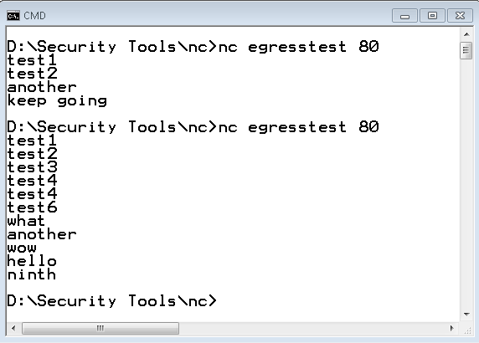
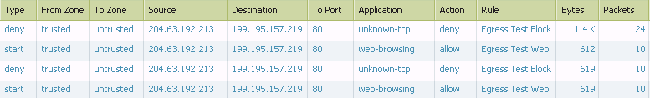
Logs during netcat test showing kills eventually
Client
3 of 4 made it
9 of 10 made it
Server
Traffic is allowed and type is incomplete

Slide 16
Palo Alto Response
Working as expected
Not a proxy
Inspecting the packet before releasing would impact performance
Traditional firewall would let all packets through, not just first
Fair enough

Slide 17
Taking Advantage of the Rules
At least 1 packet will always be allowed
Need something to send data with 1 packet per TCP session
TCP handshake
Send 1 full packet
Close session
Repeat until input is done

Slide 18
ngfw_egress.pl
First attempt
Few different modes
Will show an example of the file transfer mode

Slide 19
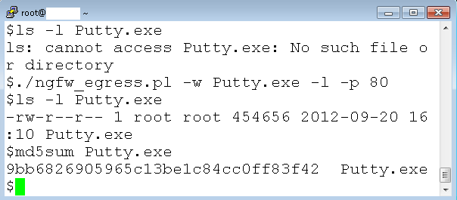
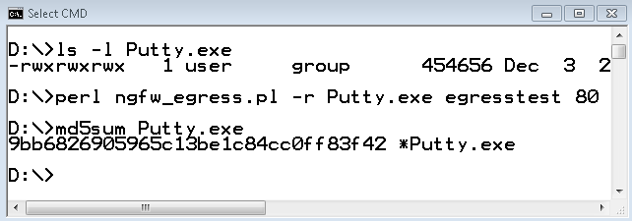
ngfw_egress.pl server and client commands
1
2
6
7
Client
Server
3
4
5
Server: ./ngfw_egress.pl –w Putty.exe –l –p 80
Client: perl ngfw_egress.pl –r Putty.exe egresstest 80

Slide 20
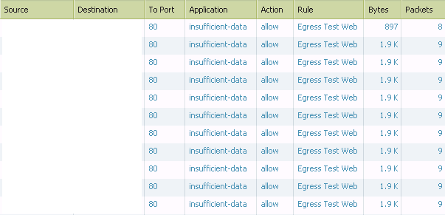
Logs during ngfw_egress.pl run
Traffic is allowed and type is insufficient-data
9 Packets:
Handshake (3): SYN, SYN/ACK, ACK
Data Transfer (2): PSH/ACK, ACK
Teardown (4): FIN, ACK, FIN, ACK

Slide 21
Defenses
Limit destination IP address, if possible
Limit ports, if possible
Use a Proxy with Protocol Detection
Very noisy
Monitor logs
High # of connections, little data per connection

Slide 22
Similar Bug?
BugTraq
http://seclists.org/bugtraq/2011/Jan/6
Plunging Through the Palo Alto Networks Firewall
Involves FW allowing traffic categorized as “Unknown TCP”

Slide 23
Future Plans
Perl Script already has more features
Delay, MSS (potential IDS/DLP evasion), interactive mode
Problems with attaching to shell
Trying a bash script that calls netcat
Wouldn’t require Perl installed
Can use netcat’s “-e” option directly
Not sure how painful cmd.exe version will be
Metasploit handler and payload
Would love to know if it works with others
Fortinet, SonicWall, etc.

Slide 24
Code and Updates
Code on GitHub:
https://github.com/superponible
Updates and Information:
http://superponible.com
@superponible

Slide 25
Questions/Comments?
Contact:
dave@superponible.com
@superponible
http://superponible.com

